Slide 1
Department of VA’s CSEMO Connect
What is CSEMO Connect?
VA’s collaborative website created exclusively for the Senior Executive (SE) Community
A website that provides a “one-stop-shop” featuring relevant news, events, executive lifecycle management, and tools you need for success
An environment where SEs can learn, share knowledge, and collaborate to realize efficiencies and best practices to better serve Veterans
Created to guide SEs through all facets of their VA work experience and to support communication across the Department

Slide 2
Department of VA’s CSEMO Connect (con’t)
What can I find on the CSEMO Connect site?
CSEMO Connect Homepage: Contains key CSEMO information, announcements, events, and CSEMO Program sites linked to critical Program-specific information
SE Gateway: Critical CSEMO, VA and External information, including Secretary McDonald’s daily Standup Briefings and links to valuable resources
Biographies: Senior Executive Biographies with search capabilities to easily find SEs by state, last name, VA Organization, or other search criteria, as well as photos and VA Organizational Charts
SE Network: Collaboration resources to help SEs engage with each other; features Communities of Practice (CoPs) for each Strategic Leadership Course (SLC) cohort to allow SEs to engage in meaningful dialogue, share ideas and best practices, and collaborate to solve critical problems

Slide 3
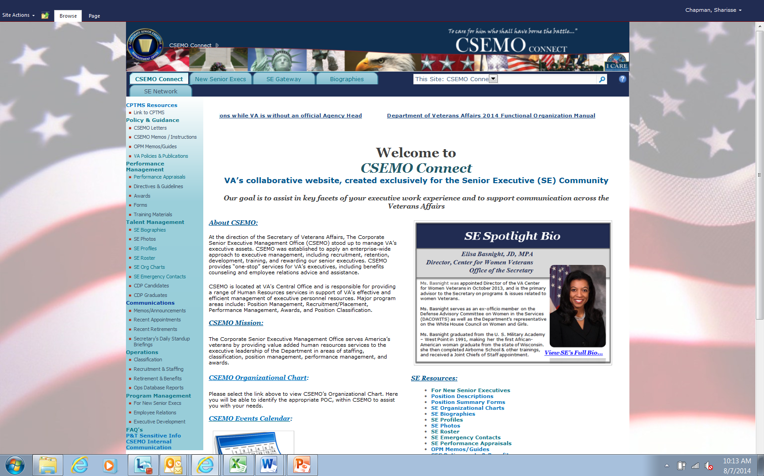
Department of VA’s CSEMO Connect (con’t)
Snapshot

Slide 4
Department of VA’s CSEMO Connect (con’t)
Summary of Links
Program Management: Employee Relations, Executive Development, Banner Tab for “New Senior Execs”
Communications: Secretary’s Daily Stand Up Briefing
Operations: Classifications, Benefits and Retirement
Talent Management: SE Profiles, Org Charts, Emergency Contact Info, Photos and Biographies
Policy & Guidance: OPM Memos, VA Policies/Publications
Performance Management: Performance Appraisals
CPTMS (Corporate Performance & Talent Management System)

